Slide 1
Event Management Platform
Revolutionizing Event Management with AI-Powered Efficiency

Slide 2
Challenges in Traditional Event Management
- Unorganized vendor management
- Time-consuming coordination
- Lack of pricing transparency

Slide 3
A One-Stop AI-Powered Event Management Hub
- Unified platform for all event services
- AI-powered recommendations and chatbot assistance
- Real-time availability and secure payment

Slide 4
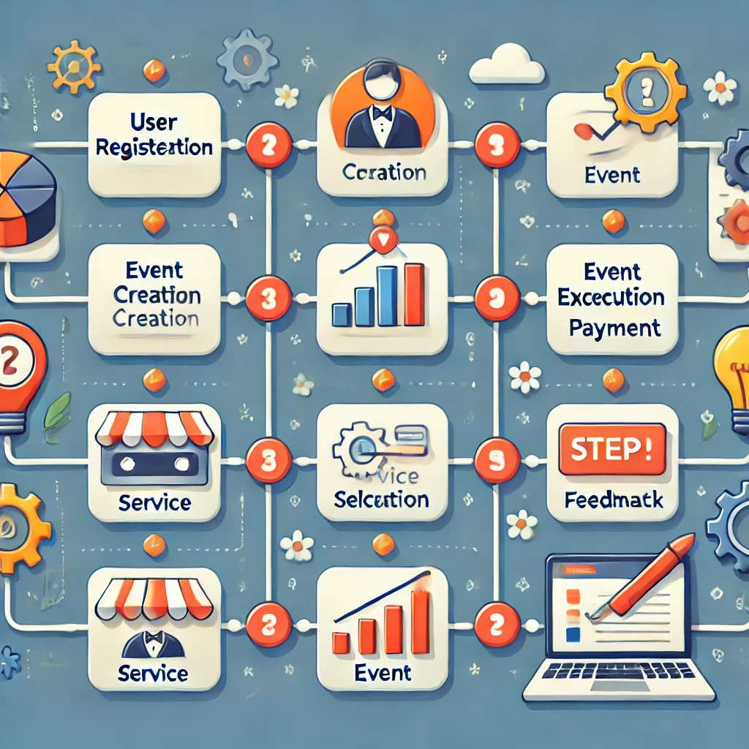
How Our Platform Works
1. User Registration
2. Event Creation
3. Service Discovery
4. Booking & Payment
5. Event Execution
6. Feedback & Analytics

Slide 5
Intelligent Features for Seamless Event Management
- Personalized Service Recommendations
- AI Chatbot for 24/7 Assistance
- Smart Vendor Suggestions and Dynamic Pricing
- Sentiment Analysis for Feedback

Slide 6
Exploring a Billion-Dollar Industry
- Event management market size in India and globally
- Growing demand for digital platforms
- Untapped potential in weddings, corporate, and cultural events

Slide 7
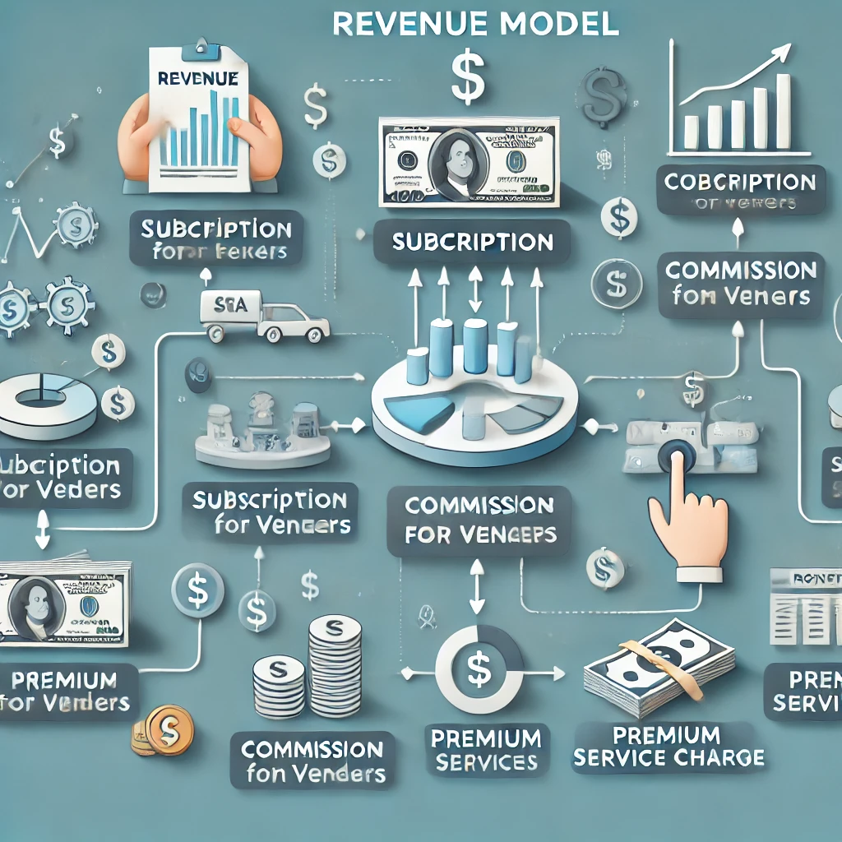
Sustainable and Scalable Business Model
- Vendor commission fees
- Subscription model for premium services
- Ad placements for local vendors

Slide 8
What Sets Us Apart
- AI-powered decision-making
- Vendor diversity and quality control
- Cost-efficiency and user convenience

Slide 9
Scaling Our Vision for Success
- Phase 1: Platform Development and Vendor Onboarding
- Phase 2: AI Enhancement and Real-Time Analytics
- Phase 3: Nationwide Expansion and Partnerships

Slide 10
Join Us in Revolutionizing Event Management!
- Summary of the platform’s value
- Potential to disrupt the event management industry
- Call to action: Partner with us for a new era in event planning

Slide 11
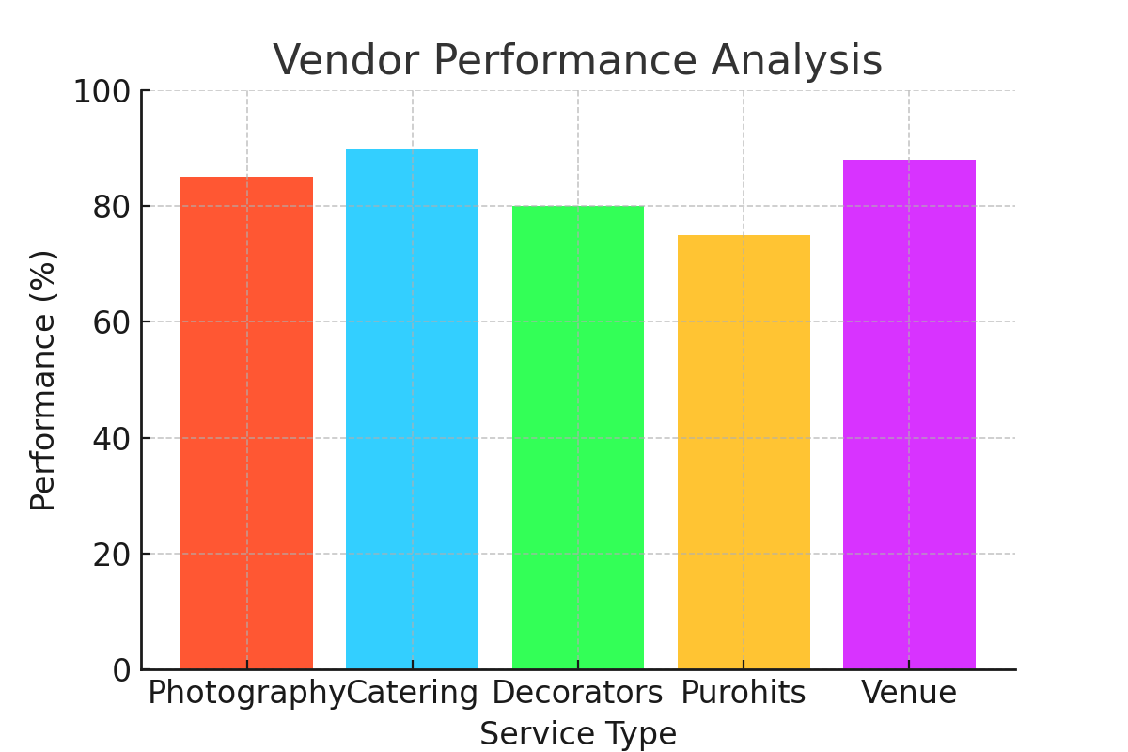
Vendor Performance Analysis

Slide 12
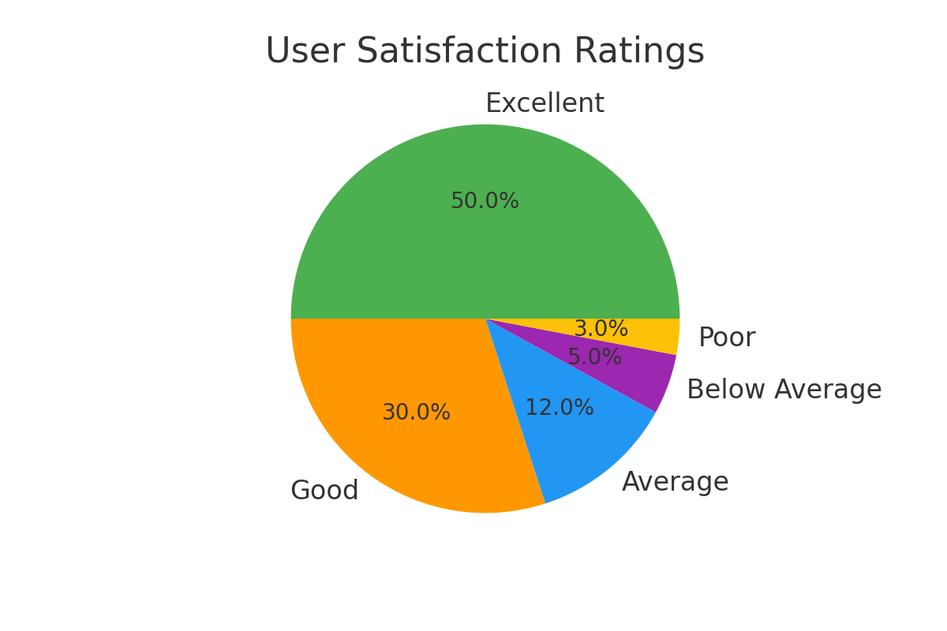
User Satisfaction Ratings

